Slide 1
Python Optimization

Slide 2
Simple Ground Rules
Make it Run correctly
Make it right for fault tolerance
Male it Fast

Slide 3
Basic Test for speed
Time a script
Time python d4p1.py
On windows I am using Cygwin
On normal unix environmenst you could use Time
User - Time spent by all CPU
Sys – Time spent for doing system related tasks

Slide 4
Some Other Simple tools
python -m cProfile -s tottime d4p1.py
python -m cProfile -s tottime –o prof.out d4p1.py
%prun %run d4p1.py
All fairly simple tools that help do dynamic analysis of the script
ncalls tottime percall cumtime percall filename:lineno(function)
1 0.000 0.000 0.000 0.000 {built-in method builtins.exec}
1 0.000 0.00 0.000 0.000 d4p1.py:6(<module>)

Slide 5
Dissecting the profiler
ncalls tottime percall cumtime percall filename:lineno(function)
1 0.000 0.000 0.000 0.000 {built-in method builtins.exec}
ncalls – number of times the function was called
Tottime – Spent in this function without fanouts
Cumtime – total time including the function call

Slide 6
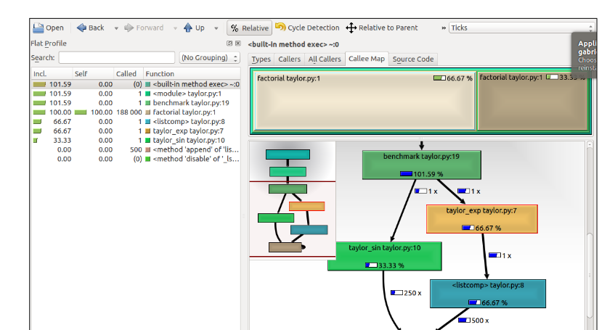

Visualize using call graphs

Slide 7
Use a simple alternative to time functions
import timeit
def my_function():
y = 3.1415
for x in range(100):
y = y ** 0.7
return y
print(timeit.timeit(my_function, number=100000))

Slide 8
Interns
Use sys.intern(“Some String”)
import sys
b = sys.intern("A Really long string")
a = sys.intern("A Really long string")
print(b is a)
c="A Really long string"
print(c is a)

Slide 9
Use default sort and generators (d4p23)
import operator
test = [(11, 52, 83), (61, 20, 40), (93, 72, 51)]
test.sort(key=operator.itemgetter(0))
test.sort(key=operator.itemgetter(1))
test.sort(key=operator.itemgetter(2))
Even if you implement the same algorithm your code is interpreted while the native call is c code

Slide 10
Easy way to Improve performance
“Not Code” the functionality in python but delegate the functionality to builtin operators such a min or sort that do a much better job
Reason : These functions are compiled c code
list = [1,2,3,'4', 'Srini']
list1 = [random.randint(0,1000) for p in range(0,1000)]
min(list1)
#min(list) wont work as we have 2 datatypes in the list

Slide 11
Use the operator module
The operator module exposes a variety of intrinsic functions such as add etc. Use these as opposed to + operation which is a an overloaded function which in turn is calling the add or __add__.
m=map(lambda x,y: x+y, random_numbers_l, random_numbers2_l)
import operator
n= map(operator.add, random_numbers_l, random_numbers2_l)
Exercise:

Slide 12
Exercise
Time the functions mentioned above
random_numbers = [random.randint(0,1000) for p in range(0,1000000)]
random_numbers2 = [random.randint(0,1000) for p in range(0,1000000)]
m=map(lambda x,y: x+y, random_numbers_l, random_numbers2_l)
import operator
n= map(operator.add, random_numbers_l, random_numbers2_l)

Slide 13
Exercise : Using KC Grind/cProfile/AST
Analyize your functions for the number of times it is being called.
Python is a dynamic type language and function overheads are fairly expensive
Use the call stack to see the number of times the function is being called and then optimize
For the code that you submitted yesterday
How modular was your code
Note the function stack overheads and see if you can optimize these by using operators

Slide 14
Exercise
Try and optimize this function note outer is calling inner
x = 0
def inner(i):
global x
x = x + i
def outer_1():
for i in range(100000):
inner(i)
Hint: delegate the range to inner: Check timings and let me know

Slide 15
Solution
x = 0
def aggregate(list):
global x
for i in list:
x = x + i
def outer_2():
aggregate(range(100000))

Slide 16
Use set operators
3 in [1, 2, 3] # => True
Set operators membership checking such as “in” and “not in” are extremely fast
So if membership checking is a frequently done operation try to move the complex datatype from a list to a set or a dictionary
This would create a hashable object that would improve the performance quite significantly
Try an exercise of creating a random list and set with the same numbers say in range 1 to 1000 a list of 100 numbers and check for membership
Note the times and let me know which of them is faster.
Note that 3 in [1, 2, 3] # => True is perfectly valid

Slide 17
Use inbuilt operators
For string using join is much faster that a +=
Try to make this code faster
def make_string(a_list):
mystring = ''
for x in a_list:
mystring += x
return mystring
mylist = [x for x in 'abcdefghijklmnopqrstuvwxyz']
Exercise: Read a file into a list and compute the check sum of the list . Simplistic adding the numeric value of addition

Slide 18
Use decorators for caching in
import functools
import math
@functools.lru_cache(maxsize=2)
def memoized_sin(x):
return math.sin(x)
Exercise: Precompute the sin and cos for all values such from 0 to 90 in increments of 1 degree and compute sin(x)**2 + cos(x)**2 for a random set of 5 values each for a million time and see the performance with and without cache

Slide 19
Try the following exercise
def fib(i):
if i < 2: return 1
return fib(i-1) + fib(i-2)
Try and pre-computer the fib

Slide 20
Solution hint extender
You create your own cache and then decorate it
from functools import wraps
def cache(f):
cache = { }
@wraps(f)
def wrap(*arg):
if arg not in cache: cache[arg] = f(*arg)
return cache[arg]
return wrap
And the decorate the function using @cache

Slide 21
Suppose we have function
def to_upper_case(s):
return str(s).upper()
And we want to iterate over this

Slide 22
Loop optimize
import random
lowerlist = ['abcdefghijklmnopqrstuvwxyz'[:random.randint(0,25)] for x in range(1000)]
upperlist = []
def to_upper_1():
for word in lowerlist:
upperlist.append(str.upper(word))
to_upper_1()
Optimize this [ hint precompute the reference to the ‘.’ operator]

Slide 23
Solution
upper = str.upper
append = upperlist.append
def to_upper_2():
for word in lowerlist:
append(upper(word))
to_upper_2()

Slide 24
Global variable vs Local Variables
Global variable are more expensive than local variables as they are stacked up with several pointer in-direction to keep track of them
Use local variable instead and see the performance in both cost and space
Exercise: Try to create local copies of the previous exercise
And pre-compute these values and try and see the time performance for lets us say 100,000 operators

Slide 25
Solution
def to_upper_3():
upperlist = []
upper = str.upper
append = upperlist.append
for word in lowerlist:
append(upper(word))
return upperlist
upperlist = to_upper_3()

Slide 26
Iterators are expensive
Where possible use a map function
def print_iterator(it):
for x in it:
print(x, end=' ')
print('') # for new line
Exercise: Optimize this by use a map function

Slide 27
Solution
def to_upper_case(s):
return str(s).upper()
# map() with string
map_iterator = map(to_upper_case, 'abc')
print(type(map_iterator))
print_iterator(map_iterator)

Slide 28
Alternative Solution
Try doing a list comprehension for the same and see if it is faster . This is as fast if not faster than map function
For loops in comprehensions are pieces of c for loops
Map is called in internally where possible

Slide 29
Solution
lowerlist = ['abcdefghijklmnopqrstuvwxyz'[:random.randint(0,25)] for x in range(1000)]
upperlist = [str.upper(x) for x in lowerlist]
Try this on a large object like a file downloaded

Slide 30
Lazy load imports
Try and use imports as far down the line as possible
def func1():
import string
string.lower('Python')
import string
def func2():
string.lower('Python')

Slide 31
If possible eliminate imports
def func3():
'Python'.lower()
/* Get away from the c++ style or rather c style of having #include in the beginning of your program. C++ anyways compiles it to include and load relevant callable functions only when absolutely needed */
# Remember think global but act local – make in India

Slide 32
Exercise
See some of the code that you have written for yesterdays assignment and try and see where you could actually use lazy loading – just when needed and only functions that are needed

Slide 33
Exercise for the day
You had day2 exercise for implementing a multi threaded downloader . Optimize this with what you have seen so far
Optimize your d3 exercise 1 – the stock trading example

Slide 34
Effective uses of in operation (d4p20.py)
See the code base for an additional example of the in operator

